Slide 1
Single-Source 3D Optical Wireless Positioning
Kevin Jose ACUNA CONDORI
01/10/2026

Slide 2
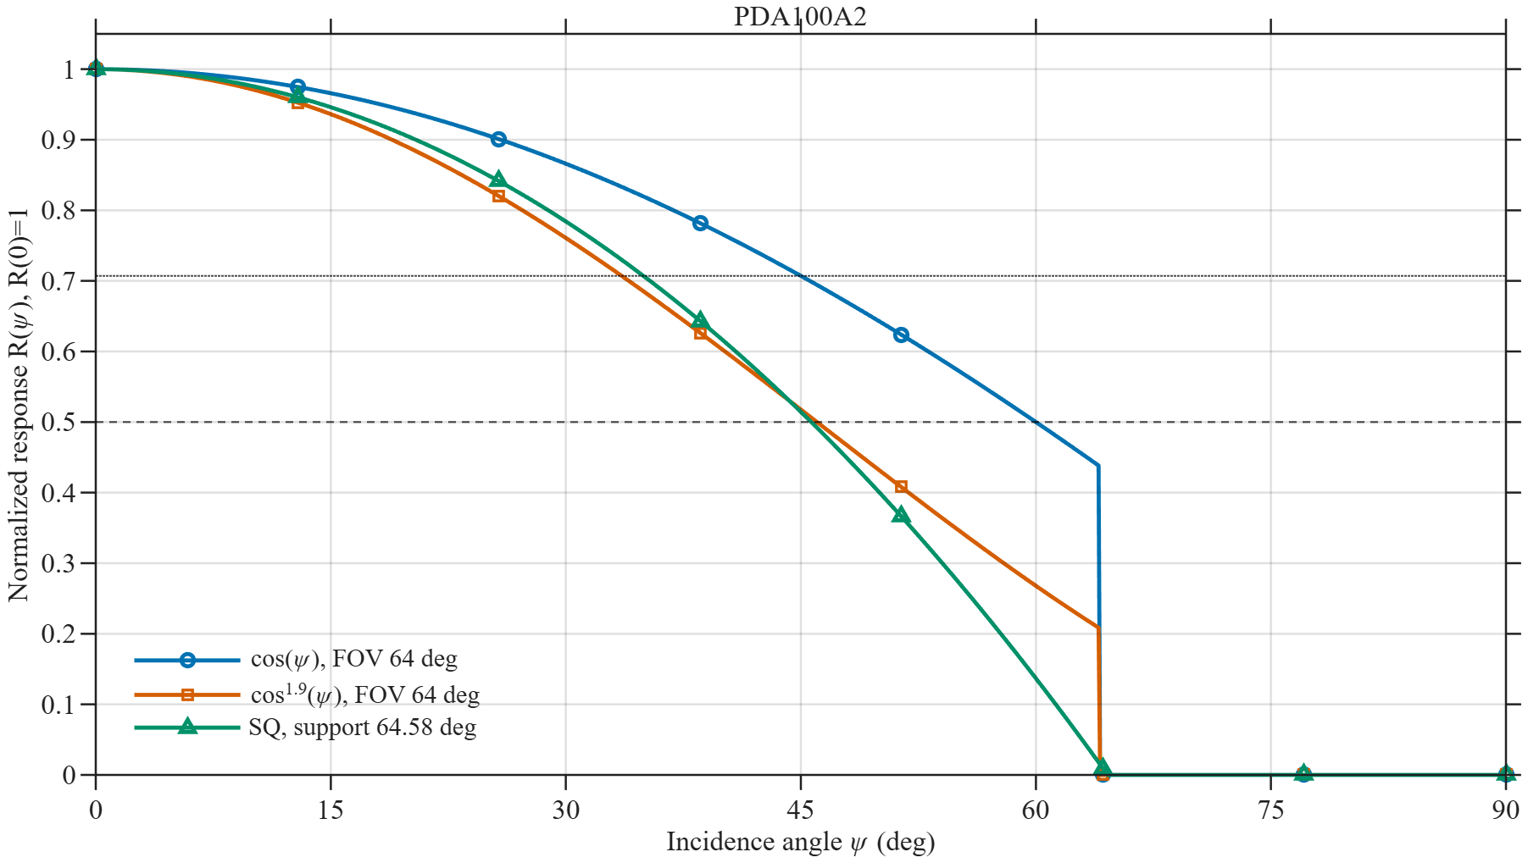
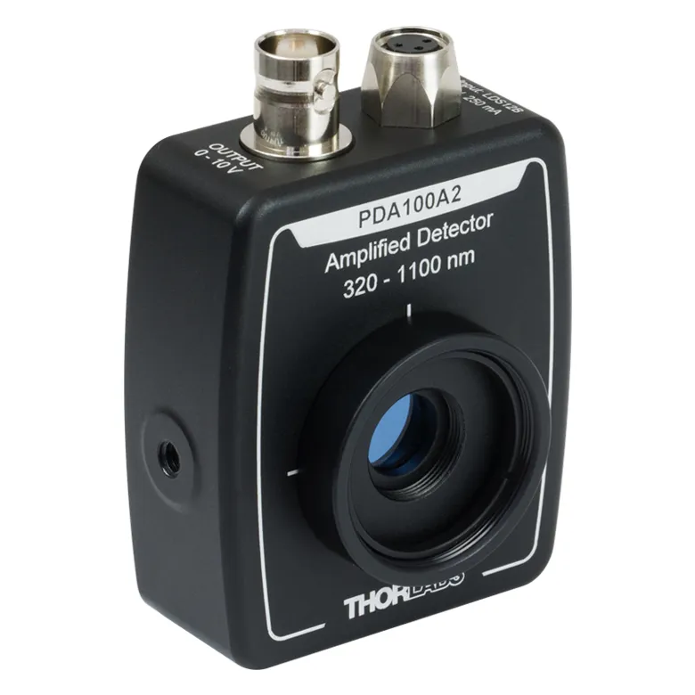




RESPONSIVITY
$$\cos{(ψ)}$$
Conventional but less accurate
Most accurate but less standard
$$1−Cψ^{2}$$
Generalizable and clean
$${\cos{(ψ)}}^{m_{R}}$$
$$FOV$$

Slide 3
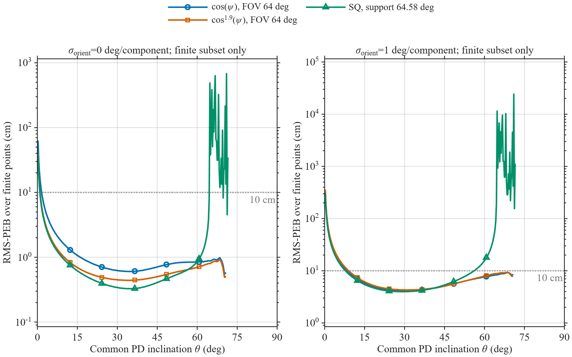
3D RMS PEB

Slide 4
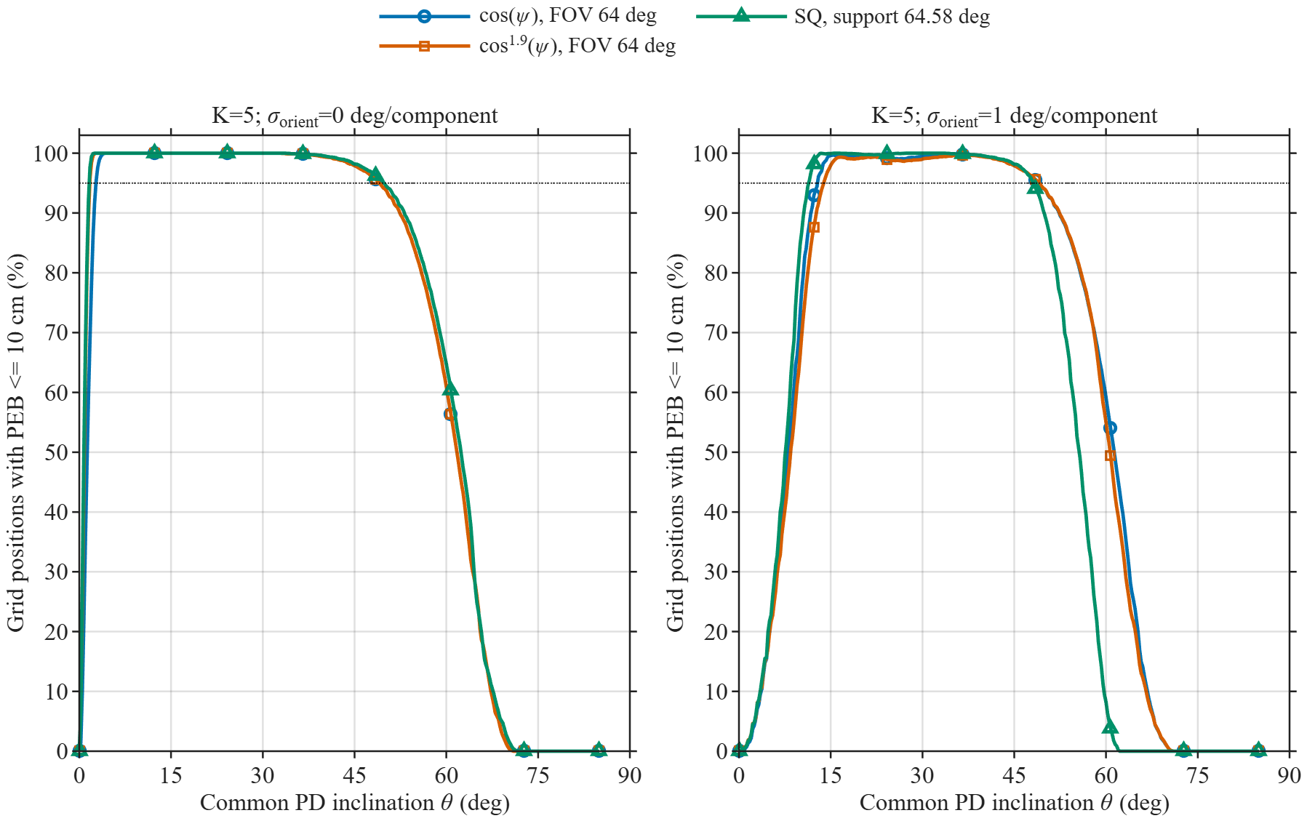
COVERAGE

Slide 5
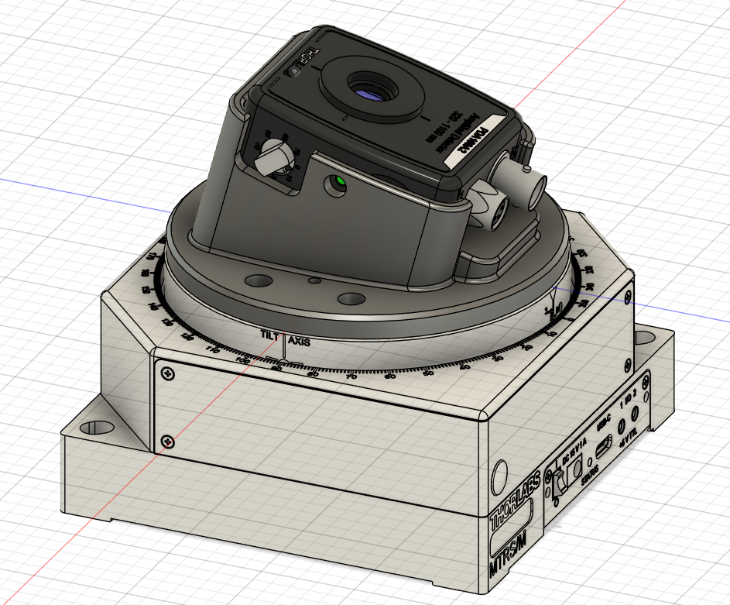
3D DESIGN

Slide 6
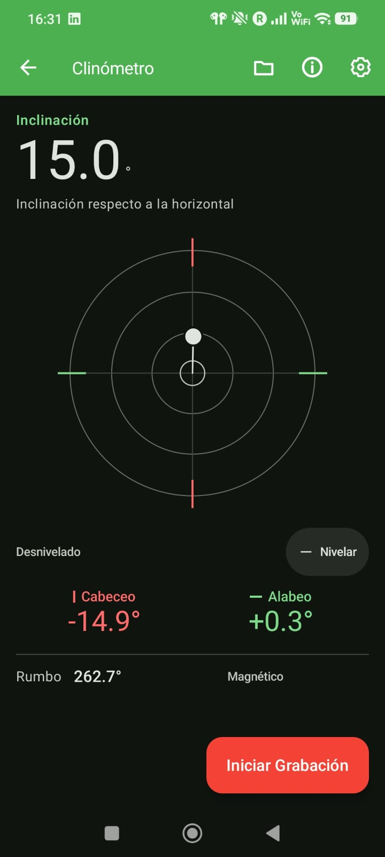
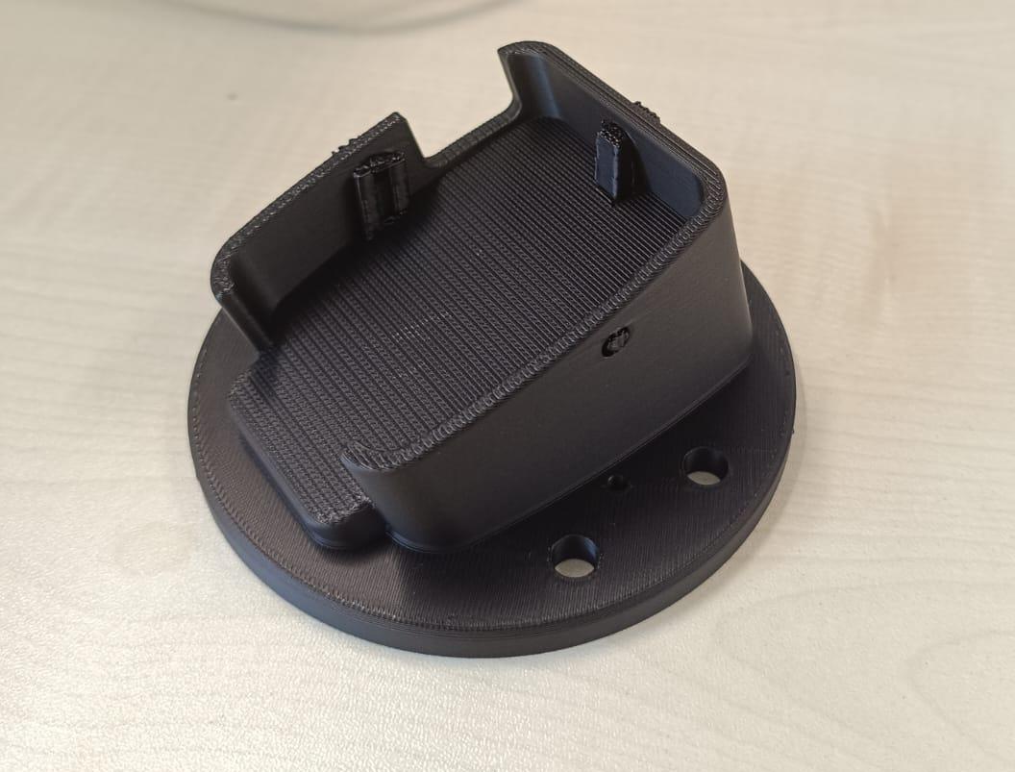

Slide 7
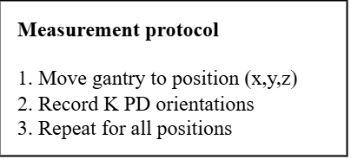
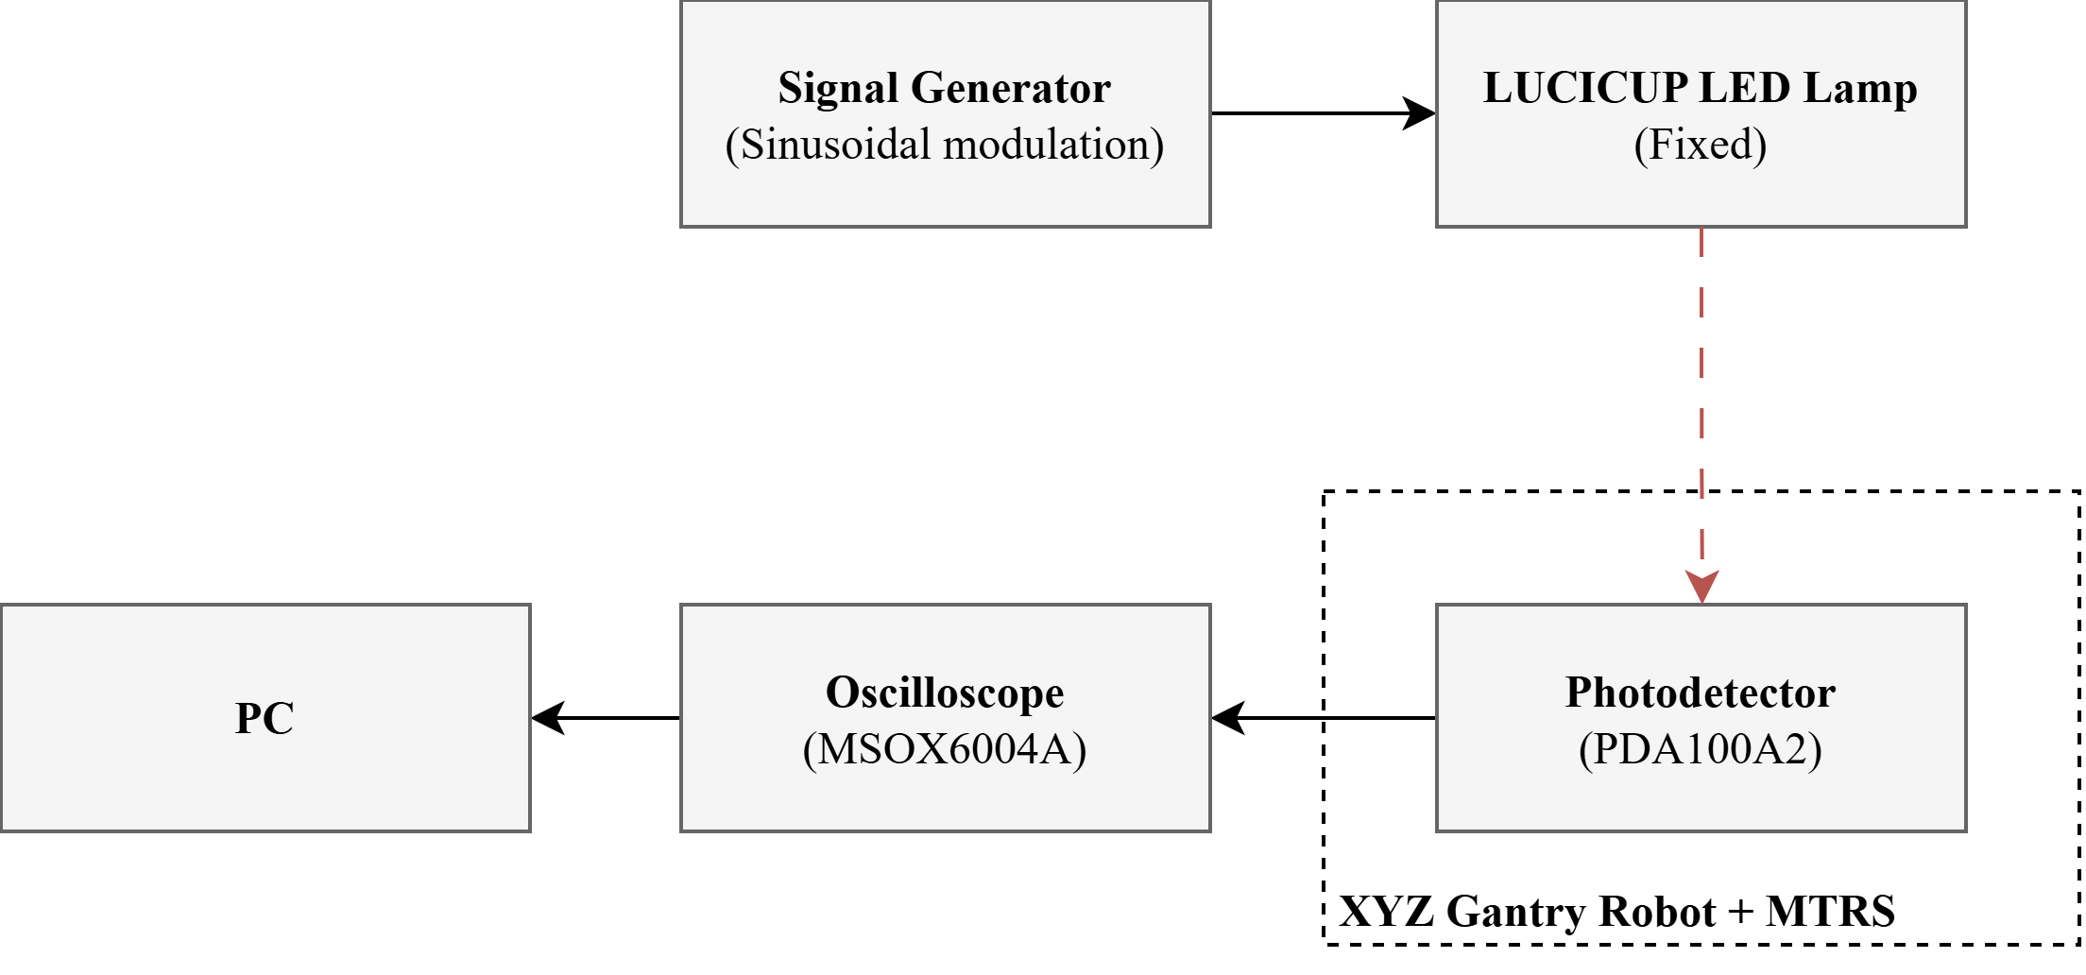
Proposed open research output: experimental VLP dataset to be published on Zenodo/Apollo

